Slide 1


Chief Operating Officer
Greg Johnson
MDOT’s Innovation Hub:
Paperless E-Project
March 18, 2015

Slide 2
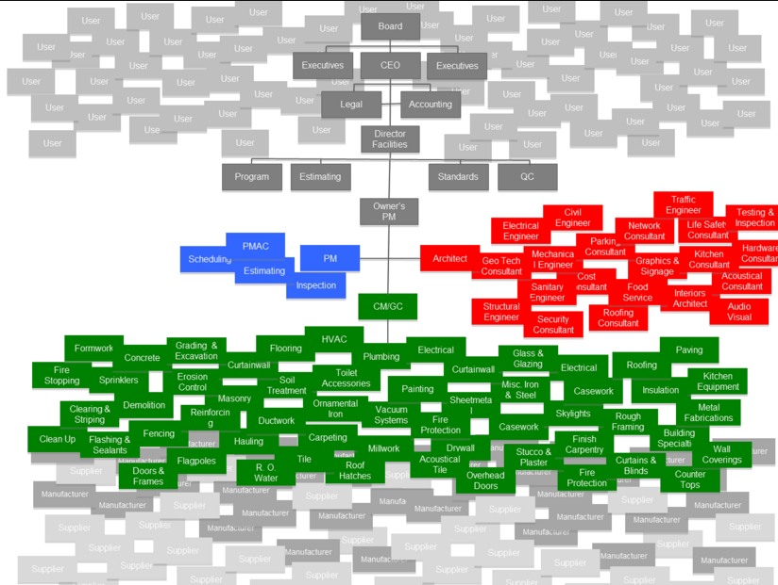
Number of People Involved in a Construction Project
Government: State DOT, Local County/City,
& FHWA
Users and Stakeholders
Consultants
Contractors, Subcontractors, Suppliers, Fabricators, Vendors, etc.
7 Million Sheets of Paper

Slide 3
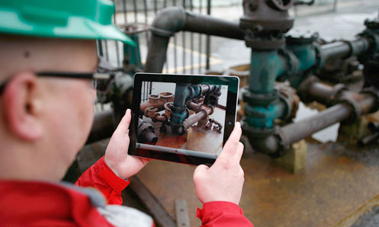
e-Project
The culmination of several automated processes resulting in paperless construction.

Slide 4

How Does e-Project Work?
Manage projects with electronic devices
Instantaneous business process flow
Data starts and ends electronically
No more lost paperwork
Electronic signatures
Increases communication
Quicker approvals

Slide 5
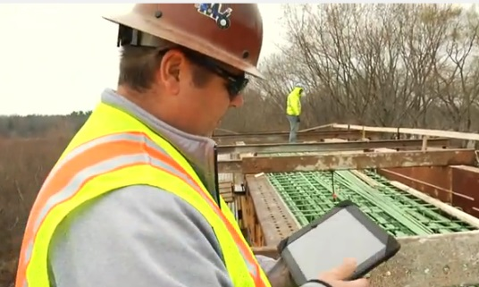
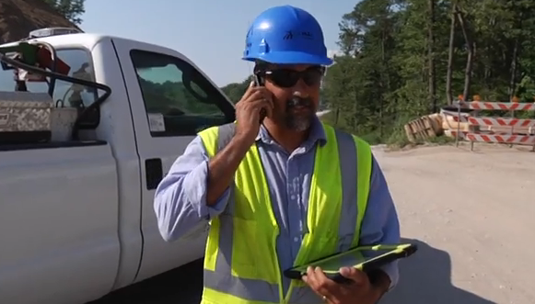
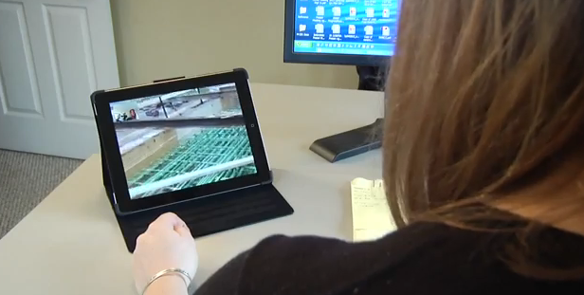
How Does e-Project Work?
(cont.)
Real-time access to experts & partners
Timely payment for completed work
Inspectors able to spend more time on job site
Increases inspector efficiency & faster problem solving
Great documentation training tool

Slide 6
What’s Involved
Leveraged an existing software infrastructure
Upgraded inspectors from flip phones to smart phones and iPads
Resulted in:
  Immediate productivity gains
  Surpassed the initial start-up costs
  Increased employee & stakeholder engagement
    Enthusiasm drove the process
    Users presented ideas to make process even better

Slide 7

Statewide Implementation
MDOT’s Goal:
All trunkline contracts to use
e-Construction documentation by the 2015 construction season
All lettings started October 1, 2014

Slide 8
Why e-Project?
Save TIME, MONEY & more EFFICIENT
Reduces costs
Immediate document distribution
  No time or money wasted printing & mailing documents
Faster approval
Faster, more accurate payments to contractors
Transparency: Documents available for viewing
Accountable: Submittal/approval dates readily available to all
Portable: Available from any device, any time, any where
Documents are secure & backed up
Responds to the reality of having less staff
Paper reduction supports “green” environment

Slide 9
Where is MDOT today?
The following stakeholders are in production, including:
  All MDOT construction & materials offices
  119 contracting firms
      322 contractor users
  31 consultant firms
      156 consultant users
  22 FHWA users
  31 active contracts
      $354 million as-let contracts

Slide 10
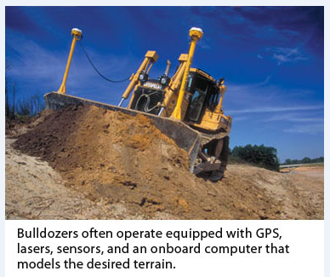
Other Innovations on Deck
3D Models
  Machine Guidance/
  Machine Control
  On-site inspection
Field electronic plan view & as-built markup
Referencing common plan & proposal information (Boilerplate)
Radio Frequency Identification (RFID) of item materials
Enterprise Asset Management System

Slide 11
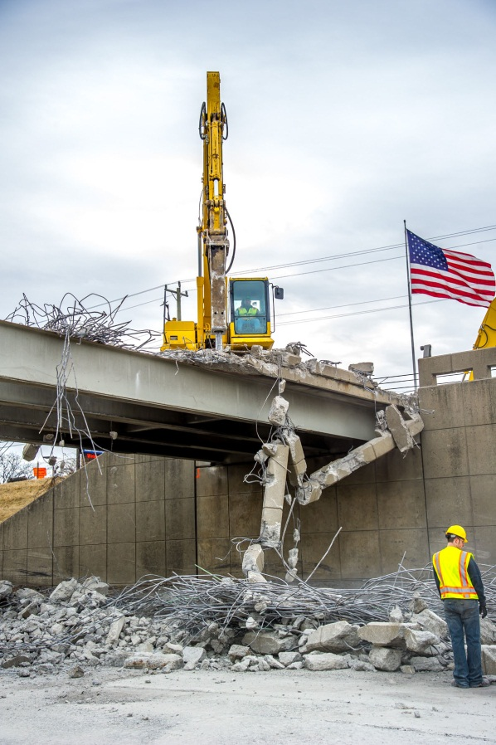
Case Study I-96 (SE Michigan)
Project Overview
$148,427,744 contract
  (16% under Engineer’s Estimate)
Dan’s Excavating, Inc.
  AJAX Paving
  C.A. Hull Company (Bridges)
7 miles, 8-lane reconstruction
37 bridges
$150,000/day opening to traffic incentive/disincentive

Slide 12
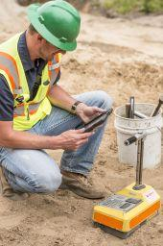
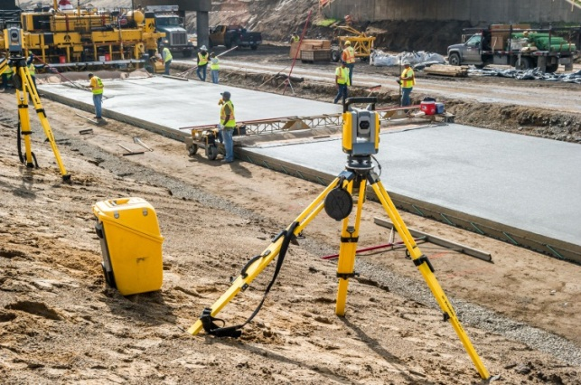
Project Innovations
E-Project
LCP Tracker & B2GNow
Stringless Paving & Automated Grade Control
A+B Modified Best Value Contracting
Partnering
Dynamic Traffic Assignment Model
Social Media
Queue Detection Warning System

Slide 13
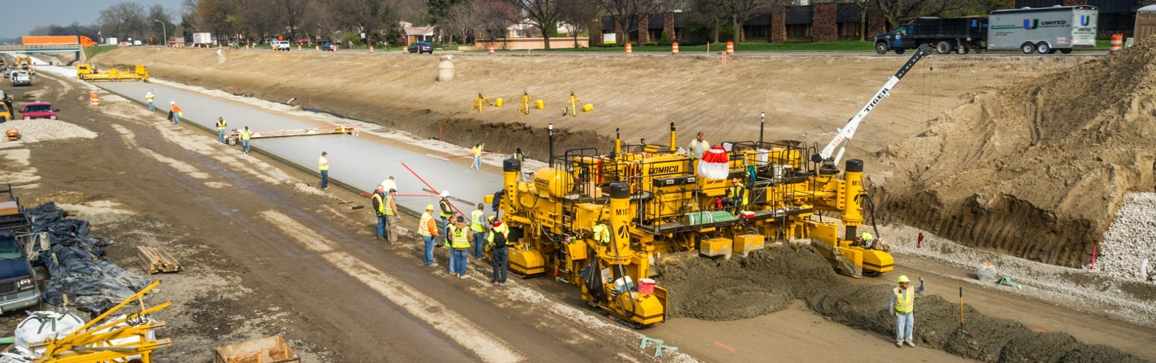
Project Status
Contractor bid 165 days
  23 days in legitimate “Extensions of Time”, so 188 days allowed
  Opened in 167 days (morning of September 22nd)
  Contractor earned 21 days incentive, or, $3,150,000
55 Contractors/Truckers Worked on the job
400 Workers on the job daily
  1250 total individuals worked at some point during the project

Slide 14

A Contractors Perspective
Mike Malloure C.A. Hull
How this approach helped C.A. Hull
Efficiencies realized
Cash flow
Technology needed
Time of return for technology investments
Issues with the design files
Disputes
Advice for consideration

Slide 15
Successful Innovations
US-131 Lateral Bridge Slide
15

Slide 16
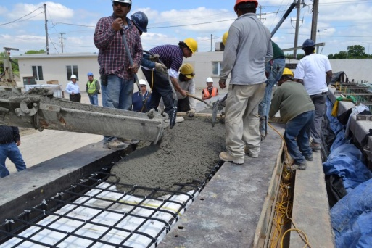
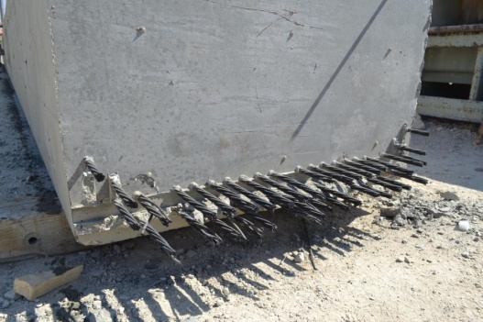
Successful Innovations
Carbon Fiber
  M-102 over Plum Creek in Detroit is MDOT’s
  first use of CFRP pre-stressing strands
16

Slide 17
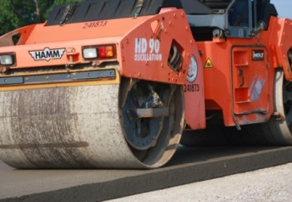
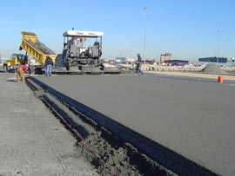
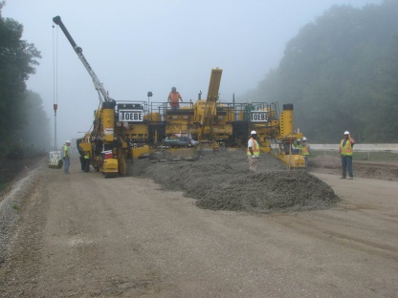
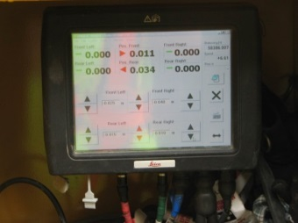

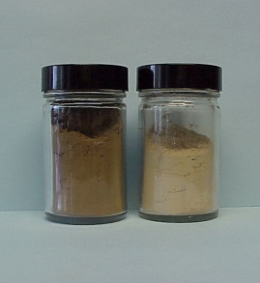
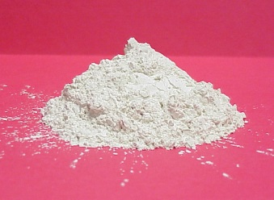
Concrete Innovations
Roller Compacted Concrete
  Competitive Alternative for Low Volume Paving Applications
Stringless Paving (3D Paving)
  Reduced Construction Staking Costs
  Improves Safety
  Improves Speed of Paving
Improved Supplementary and Blended Cements for Environmental Sustainability
  Enhanced Concrete Durability
  Reduced Carbon Footprint
17

Slide 18
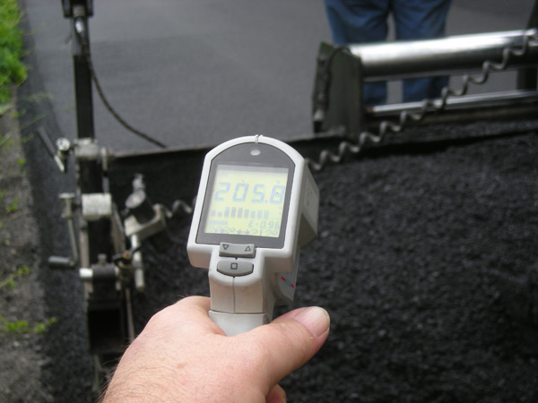
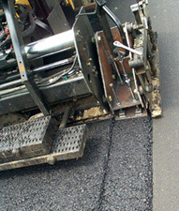
Asphalt Innovations
Regressing Air Voids In Production
  Design to 4%, Regress to 3% In Production
  Results in More Asphalt Cement in Mix
  Increased Density, Increased Performance
Fine Graded Mixes on Top Course
  Eliminate Dry, Coarse Mixes
  Resistant to Cracking
  Better Performance
Incentive for Ride Quality
  Promotes better Construction Practices/Innovation from Contractors
  Improved Ride for Traveling Public
18

Slide 19

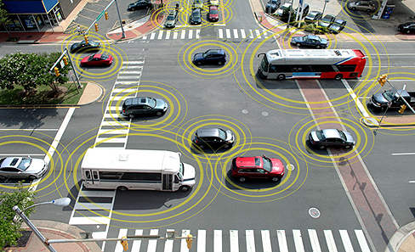
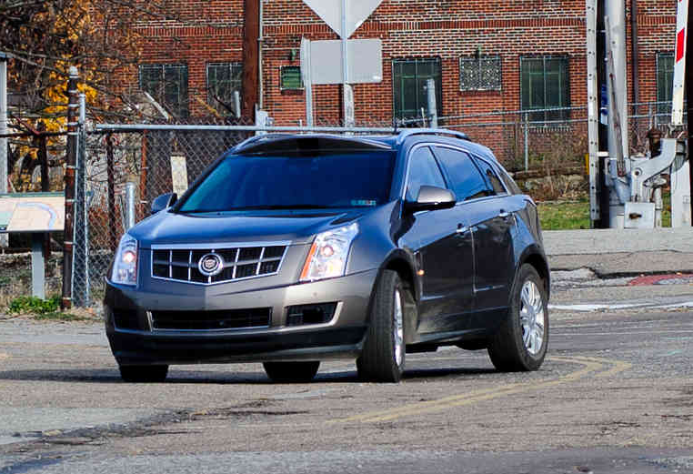
Connected Vehicles

Slide 20
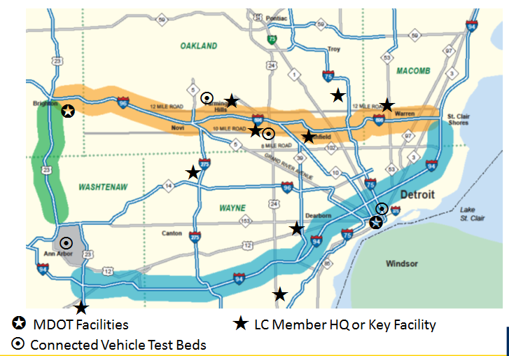
Smart Cooridor

Slide 21

Questions?

